Slide 1
I400 – Application Development in Java
Lecture 11

Slide 2
Today
CH 15 – Event Handlers
Events and Event Handlers
Creating and Linking Event Handlers
In Scene Builder
In code
Keyboard Events
Mouse Events
Other common events for common controls

Slide 3

Get ready…
If not available already:
Install JavaFx
Install SceneBuilder
Set Path for Scene Builder in Eclipse (see Lecture 10)
Start a new FXML project
New -> Other… JafaFX/JavaFX Project
Call it TwoButtonExample
Create a new FXML Document
New -> Other… JavaFX/New JavaFX Document
Call it LaunchPage
Copy and paste code from Canvas into these 2 files
Main.java, LaunchPage.fxml
Make sure program runs!

Slide 4
Events & Event Handlers
GUI controls respond to user actions
E.g. a button click
You have to tell the compiler which handler to use for which events.
You must declare an event handler for every event you want your GUI to handle.
The JVM passes this event to the proper handler at runtime.
button
event
handler
Clicking a button fires an action event
(Event source object)
An event is an object
(Event object)
The event handler processes the event
(Event handler object)

Slide 5
Controller Files
Every FXML file (which specifies layout of GUI) has an associated controller file (which defines logic of GUI)
When you call load() on an FXMLLoader, it:
Loads the FXML file
Creates an instance of the controller class specified by fx:controller
Sets @FXML-annotated fields in controller
Registers event handlers, mapping methods to controller
Calls initialize() in controller (if there is one)
Have to make sure you have filled in the “glue”

Slide 6
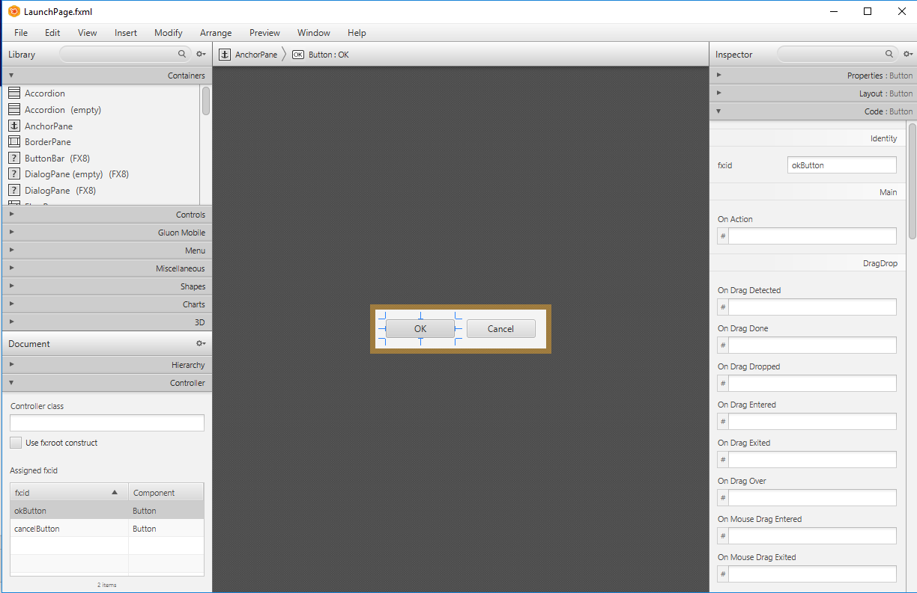
First: Give Controls Names
Open LaunchPage.fxml in SceneBuilder.

Slide 7
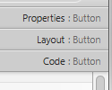



Give Controls Names
Highlight each button in turn, and switch to the Code: Button tab on the right.
Give each button an fx:id as shown:
Save in SceneBuilder, then close it.

Slide 8
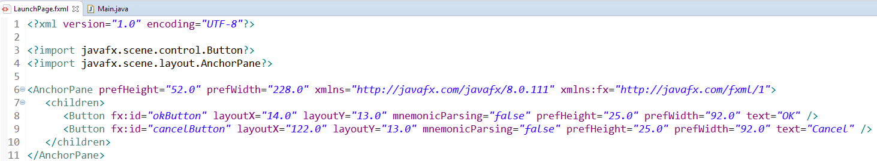
Give Controls Names
You should see this new code in your LaunchPage.fxml file:

Slide 9
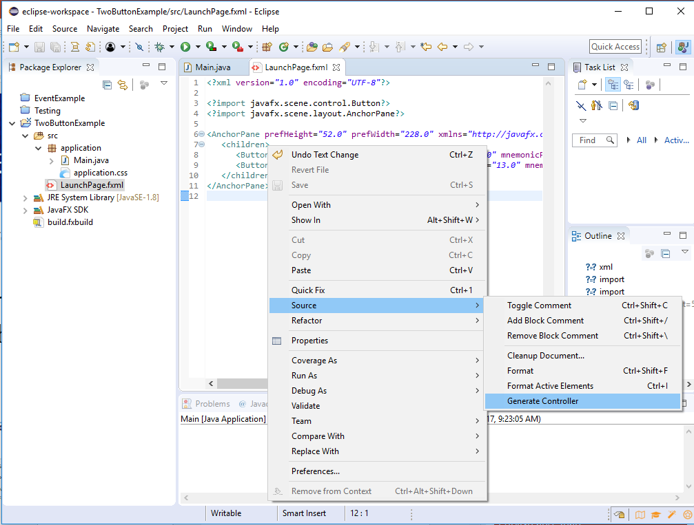
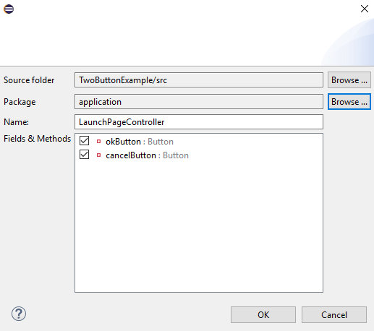
Second: Create Controller Class
For each FXML file, you need a “controller” class to handle events from the nodes in that layout.
Right click on FXML code, then select Source-> Generate Controller

Slide 10
Create Controller Class
Make sure to choose the correct package: application

Slide 11
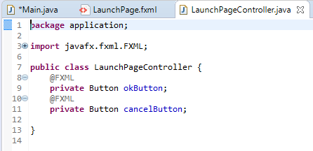
Controller Skeleton
The control names automatically show up!
@FXML tells the compiler to link this button to the GUI component with the same name in the FXML file

Slide 12
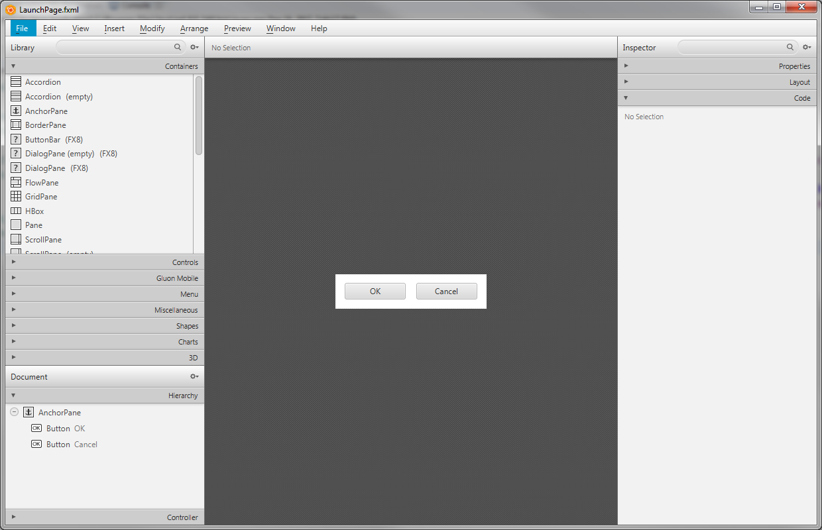
Third: Point FXML to Controller
Open LaunchPage.fxml in SceneBuilder again:

Slide 13
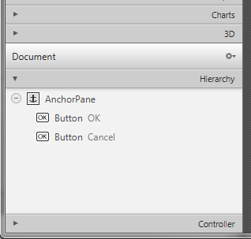
Point FXML to Controller
Select the Controller tab at the bottom left:

Slide 14
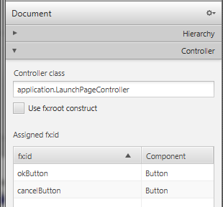
Point FXML to Controller
Make sure to specify the package and correct controller class name.
You can run the program now, but the button clicks won’t do anything yet.

Slide 15
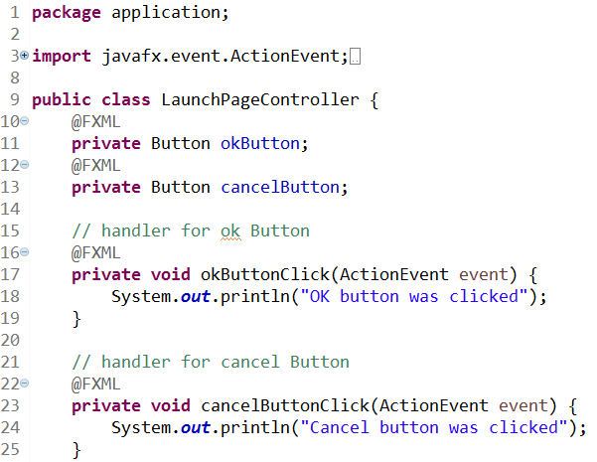
Fourth: Create Event Handlers
For every type of event you want to handle from your controls, create a handler.
It should:
Be private
Return void
Take an ActionEvent as its only argument
Make sure to import ActionEvent

Slide 16
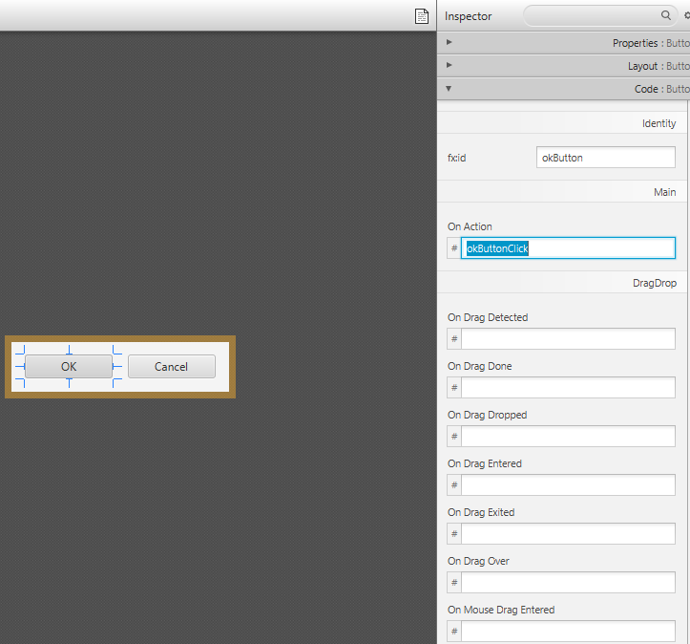
Fifth: Tell FXML about handlers
Open SceneBuilder again.
Button only has one action… tell each button to use the handler that you just created:
Ok
okButtonClick
Cancel
cancelButtonClick

Slide 17
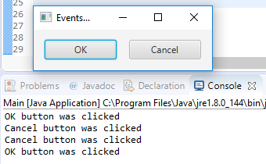
Run the Program
Now, when the buttons are clicked, you should see output in the console!

Slide 18
Summary of Steps
Give controls names in Scene Builder
Create controller class (.java)
Point Scene Builder to the controller class
Create event handlers in controller class
Point Scene Builder to event handlers

Slide 19
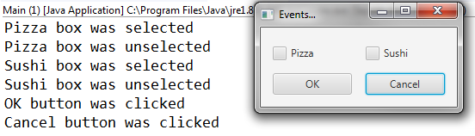
CheckBox Events (Group Work)
Add two checkboxes for food and print to the console when they get checked and unchecked.
You do not need to create a new controller class! (Steps 2 and 3)
Add new handlers to existing controller class (Step 4)
Make sure to add two CheckBox variables to the private data at beginning of controller code
Write two CheckBoxClick handler methods. In each, check if each checkbox isSelected()

Slide 20
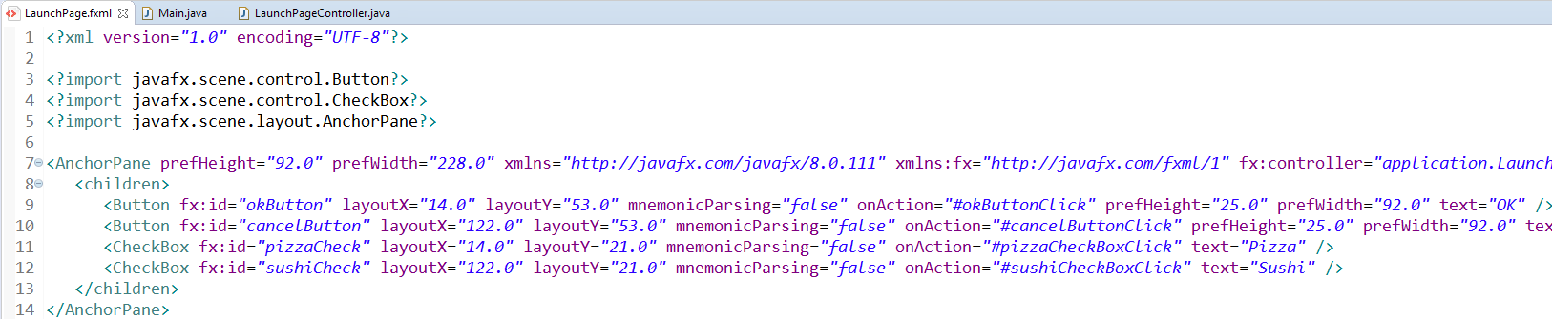
CheckBox Events (Solution)

Slide 21
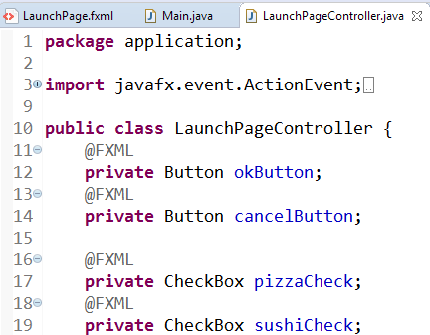
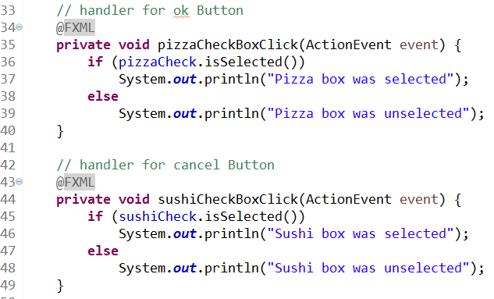
CheckBox Events (Solution)

Slide 22
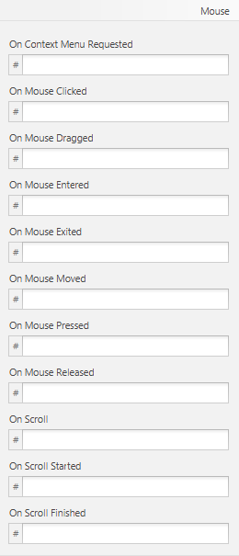
Mouse Events

Slide 23
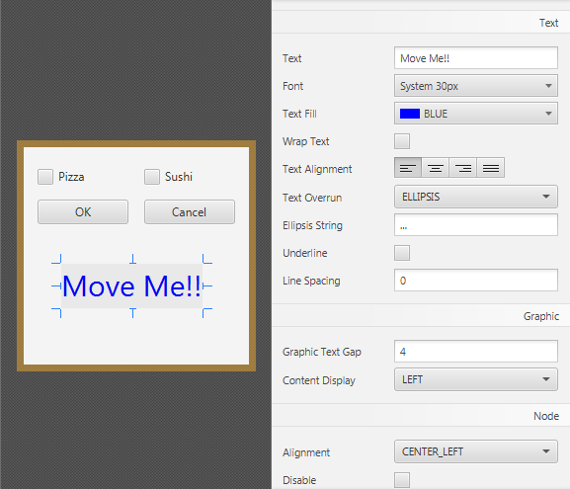
On Mouse Dragged Example
Add a new Label
MoveMe!!
Increase font size
Change Color
Make your AnchorPane longer
Set fx:id to moveLabel

Slide 24
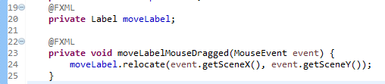
On Mouse Dragged Example
In Controller: Add handler for Mouse Dragged
(You will need to import javafx.scene.input.MouseEvent;)

Slide 25
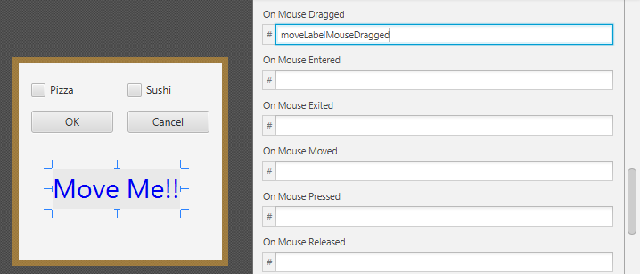
On Mouse Dragged Example
In Scene Builder: Link to the handler you just created

Slide 26
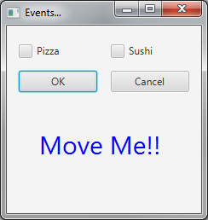
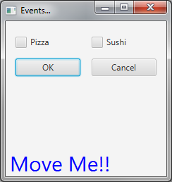
On Mouse Dragged Example
Drag Label around
with mouse

Slide 27
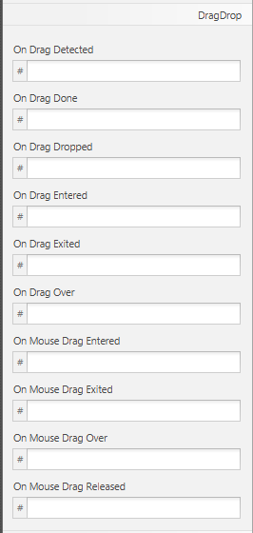
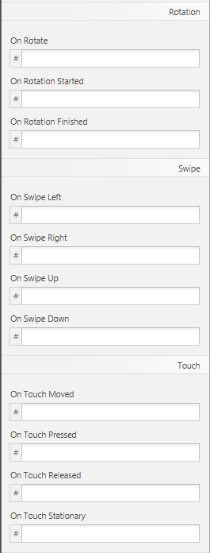
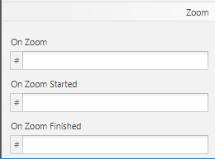
Other Common Events

Slide 28
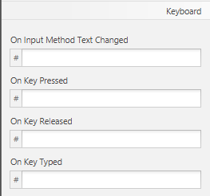
Keyboard Events
Keyboard events are of type KeyEvent
Can listen for a KeyEvent on the entire window (e.g. the AnchorPane)
Can get the specific key press with: event.getCharacter()
This returns a String, can tell difference between ‘a’ and “A”

Slide 29
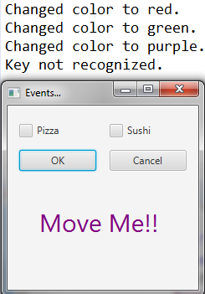
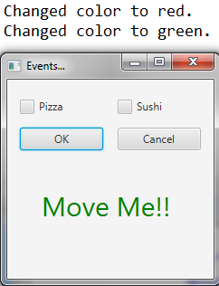
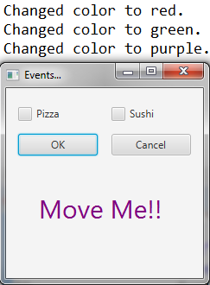
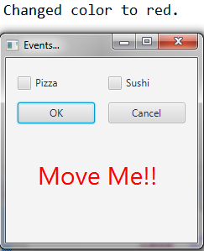
Key Event (Group Work)
We want to extend the program to change the color of the Label if the user types:
R (red), G (green), P (purple), B (blue)
Print the color change to the console as well
Print an error message if any other key is pressed.
From Canvas, download KeyEventDirections.txt for help!

Slide 30
Key Event Directions
1. In SceneBuilder, set an fx:id for the AnchorPane.
2. In SceneBuilder, set an onKeyTyped event for the AnchorPane.
3. In LaunchPageController.java, import the following additional things:
import javafx.scene.input.KeyEvent;
import javafx.scene.layout.AnchorPane;
import javafx.scene.paint.Color;
4. In LaunchPageController.java, create an AnchorPane variable.
5. In LaunchPageController.java, add the code for the event handler.
This will take a KeyEvent
You can use event.getCharacter() to get a String of
the exact key pressed. It can tell the difference
between upper and lower case!
6. In your event handler, you will need to change the colors.
Use moveLabel.setTextFill()
You can use the following colors:
Color.RED, Color.BLUE
Color.PURPLE, Color.GREEN
7. In your event handler, check for any other key being pressed and display an error message.

Slide 31
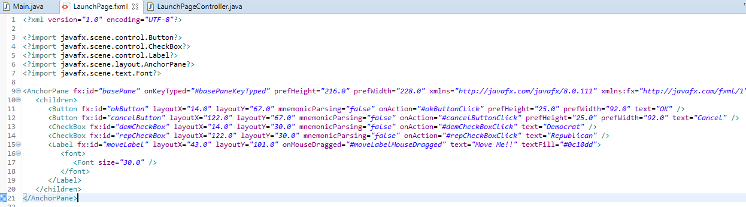
Key Event Solution

Slide 32
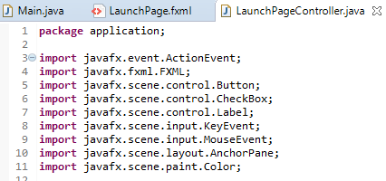
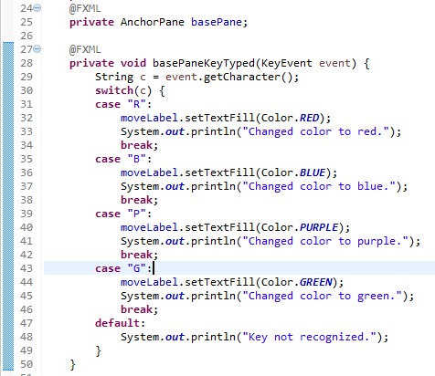
Key Event Solution

Slide 33
Questions?

